Slide 1

CS1010: Programming Methodology
UNIT 2
Computational Problems and Algorithms

Slide 2
Unit 2: Computational Problems and Algorithms
Computational Problems
Algorithm
Flowchart
Variables
Correctness

Slide 3
Computational Problems
Problems that
have well-defined inputs, outputs, and constraints
can be solved step-by-step by a computer

Slide 4
Computational Problems
Example (Decision Problem)
Is 1933091 prime?
What are the inputs, outputs and constraints?
Is there a step-by-step method to solve it using a computer?

Slide 5
Computational Problems
Example (Decision Problem)
Is there a route from a Point A to Point B?
What are the inputs, outputs and constraints?
Is there a step-by-step method to solve it using a computer?

Slide 6
Computational Problems
Example (Search Problem)
Find a route from Point A to Point B.
Example (Counting Problem)
How many different routes are there from Point A to Point B?
Example (Optimization problem)
Find the shortest route from Point A to Point B.

Slide 7
Non-Computational Problems
Examples
What is the meaning of life?
Do I look good in this outfit?

Slide 8
Problem Solving Process
Algorithmic
Determine problem features
Analysis
Iterative process
Write algorithm
Design
Produce code
Implementation
What is an algorithm?
Check for correctness and efficiency
Testing

Slide 9
Algorithm
An algorithm is a well-defined computational procedure consisting of a set of instructions, that takes some value or set of values as input, and produces some value or set of values as output.
Input
Algorithm
Output
‘Algorithm’ stems from ‘Algoritmi’, the Latin form of al-Khwārizmī, a Persian mathematician, astronomer and geographer.
Source: http://en.wikipedia.org/wiki/Algorithm

Slide 10
Algorithm: Example
Problem: Find the maximum among a list of numbers.
Sample input: 5 9 8 1 3 2
Sample output: 9
What are the inputs, outputs and constraints?
Inputs: L = ⟨l₀,...,l_{k−1}⟩
Outputs: m
Constraints: m ∈ L and m ≥ l_{i} for all i.

Slide 11
Algorithm: Example
Problem: Find the maximum among a list of numbers.
Sample input: 5 9 8 1 3 2
Sample output: 9
What is the algorithm?
Scan one-by-one
l_{i}: The number being scanned
i = 0, 1, …, k-1

Slide 12
Algorithm: Example
Problem: Find the maximum among a list of numbers.
Sample input: 5 9 8 1 3 2
Sample output: 9
What is the algorithm?
Maximum so far…
m: max so far
m: l₀ initially

Slide 13
Algorithm: Example
Problem: Find the maximum among a list of numbers.
Sample input: 5 9 8 1 3 2
Sample output: 9
What is the algorithm?
Keeping track
if m < l_{i}, then update m with the value of l_{i}

Slide 14
Algorithm: Example
Problem: Find the maximum among a list of numbers.
Sample input: 5 9 8 1 3 2
Sample output: 9
What is the algorithm?
Done scanning?
Keep going as long as we have not reached l_{k−1}

Slide 15
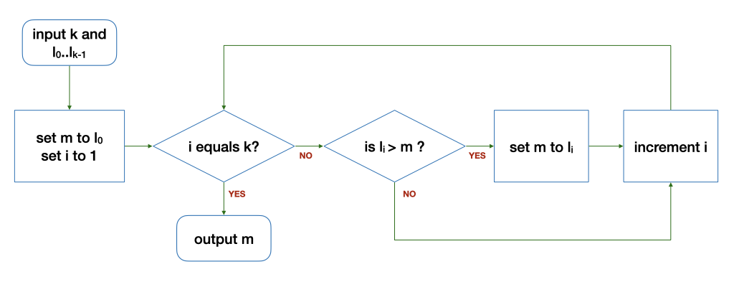
Algorithm: Example
The Flowchart
The loop
Input: 5 9 8 1 3 2
k | i | l_{i} | m | Remark
6 | 1 | 9 | 5 | Before the loop
6 | 2 | 8 | 9 | After 1st round of the loop
6 | 3 | 1 | 9 | After 2nd round…
k | i | l_{i} | m | Remark
6 | 4 | 3 | 9 | After 3rd round…
6 | 5 | 2 | 9 | After 4th round…
6 | 6 | - | 9 | After 5th round…

Slide 16
Variables
i, m, k are variables
They hold a value in a corresponding location in the memory
You can
read a value from a variable
write a value to a variable
compare values of two variables
Perform arithmetic operations on variables (e.g., set i to i + 1)

Slide 17
Control structures
Sequence
After step X, do step Y.
Selection
If … then … else …
Repetition
Keep going as long as ...

Slide 18
Correctness
An algorithm is correct (i.e., bug free) if it works on all possible inputs.
Very often, a buggy algorithm works on some inputs but fails on others…
To check correctness, you can
Find a counter-example to disprove the algorithm
Carefully choose a set of test cases to verify the correctness
Argue formally about the property of the algorithms

Slide 19
Correctness
What is wrong with this modified algorithm?
0

Slide 20
Homework
Post-Lecture Diagnostic Quiz (1%)
Due on Friday of Week 3, 4pm.
You can have up to three attempts.
Problem Set 1.1 to 1.3 (under Unit 2)
Not graded. To be discussed in Week 3 during tutorials / labs.

